Slide 1
ROBOT ARM SIMULATION
AUTHOR : NAVEENKUMAR S

Slide 2
INTRODUCTION
The Python program implements a simulation of a pick and place robot using inverse and forward kinematics. This simulation illustrates the movement of a robotic arm as it picks up a box from an initial position, moves it to a final position, and then returns to its home position. The robot's arm consists of two links, and the simulation animates the motion of these links to perform the desired pick and place tasks.

Slide 3
OBJECTIVE
The objective of this simulation is to showcase the dynamic capabilities of a pick and place robot arm. By utilizing concepts such as inverse kinematics and forward kinematics, the simulation demonstrates how the robot arm can efficiently manipulate objects within its workspace. Through animated visualization, viewers gain insight into the coordination and movement of the robot arm as it interacts with its environment.

Slide 4
PYTHON LIBRARIES
NUMPY
MATPLOTLIB
NumPy is a fundamental package for scientific computing with Python. It provides support for large, multi-dimensional arrays and matrices, along with a collection of mathematical functions to operate on these arrays.
In this program, NumPy is primarily used for mathematical operations involved in calculating inverse kinematics, forward kinematics, and manipulating array data.
Matplotlib is a comprehensive library for creating static, animated, and interactive visualizations in Python. pyplot is a module within Matplotlib that provides a MATLAB-like interface for creating plots and visualizations.
Here, pyplot is used for creating the plot for the robot simulation, setting plot properties such as labels and limits, and displaying the animation.

Slide 5
Key components of Robot arm simulation
Robot Arm model
Inverse Kinematics (IK)
The robot arm model comprises interconnected links and joints representing the physical structure of the robot. In this simulation, the arm is simplified to a two-link mechanism, where each link represents a segment of the arm, and joints connect these segments allowing rotational movement.
Inverse kinematics calculates the joint angles required to position the end-effector (in this case, the gripper or hand of the robot) at a specific location in space. This mathematical process is essential for controlling the arm's movements precisely and achieving desired end-effector positions.

Slide 6
Forward Kinematics(FK)
Animation
Forward kinematics determines the position and orientation of the end-effector given the joint angles. It allows visualization of how the robot's configuration (joint angles) translates to its spatial position and orientation in the workspace.
Animation is a crucial component for visualizing the robot arm's movement. It involves updating the positions of the arm's components (links, joints, end-effector) over time, creating a dynamic representation of the arm's motion. Animation enhances understanding by providing a visual depiction of the robot's actions.

Slide 7
Box Manipulation
Visualization
The simulation involves the manipulation of a box by the robot arm, simulating a pick-and-place operation. This aspect demonstrates the robot's capability to interact with objects in its environment, pick them up from one location, transport them, and place them at another location.
Visualization elements include graphical representations of the robot arm, the box, and any other relevant components (such as base plates or coordinate axes). These visual aids help users interpret the simulation's output by providing a clear depiction of the simulated environment and the robot's actions within it.

Slide 8
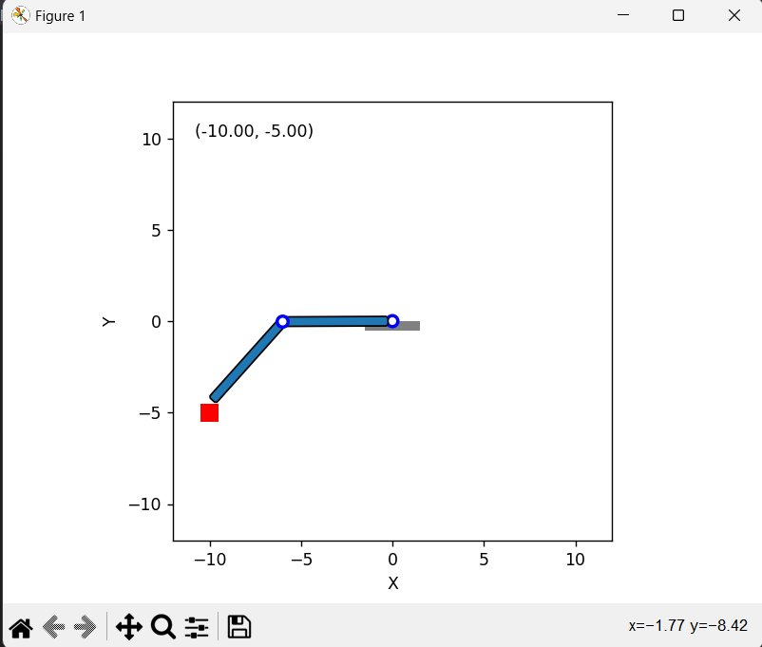
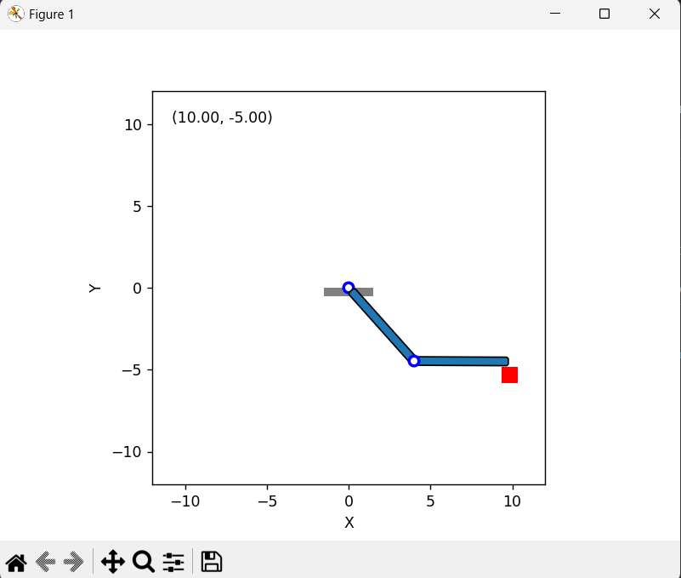
2R ROBOT ARM SIMULATION

Slide 9
CONCLUSION
This Python program provides a visual representation of a pick and place robot simulation. By employing concepts of inverse and forward kinematics, it demonstrates how a robotic arm can be controlled to perform precise tasks such as picking up and moving objects. This simulation serves as a valuable tool for understanding the mechanics and dynamics of robotic systems in a controlled environment

Slide 10
THANK YOU

